Slide 1


RESI – CI /CD Process
Date: 24 July, 2017

Slide 2
Index
Terminology
High level CI/CD process
Stepwise CI/CD Process being followed in RESI
CI/ CD process flow diagram
Branching
Tools Used
Date: 24 July, 2017

Slide 3
Terminology
Continuous Integration (CI)
is a development practice that requires developers to integrate code into a shared repository several times a day. Each check-in is then verified by an automated build, allowing teams to detect problems early.
Continuous delivery (CD)
is a software engineering approach in which teams produce software in short cycles, ensuring that the software can be reliably released at any time. It aims at building, testing, and releasing software faster and more frequently.

Slide 4
High level CI/CD process
From a high level, a CD/CD pipeline usually consists of the following discrete steps:
Commit. When a developer finishes a change to an application, he or she commits it to a central source code repository.
Build. The change is checked out from the repository and the software is built so that it can be run by a computer. This steps depends a lot on what language is used and for interpreted languages this step can even be absent.
Automated & Manual tests. This is where the meat of the CI/CD pipeline is. The change is tested from multiple angles to ensure it works and that it doesn’t break anything else.
Deployments. The built version is deployed to production.
Commit
Build
Test

Slide 5
Stepwise CI/CD Process being followed in RESI
Developers check out code into their private workspaces. (Eclipse, integrated to GitHub)
When done, commit the changes to the repository.
The CI server (Jenkins) monitors the GitHub repository and checks out changes when they occur.
The CI server (Jenkins) builds the system and runs regression and integration tests.
The CI server (Jenkins) assigns a build label to the version of the code it just built. Push notifications to Slack (team messaging system).
The CI server informs the team of the successful builds.
If the build or tests fail, the CI server alerts the team and the people who break the build.
The team member fixes the issue at the earliest opportunity.

Slide 6
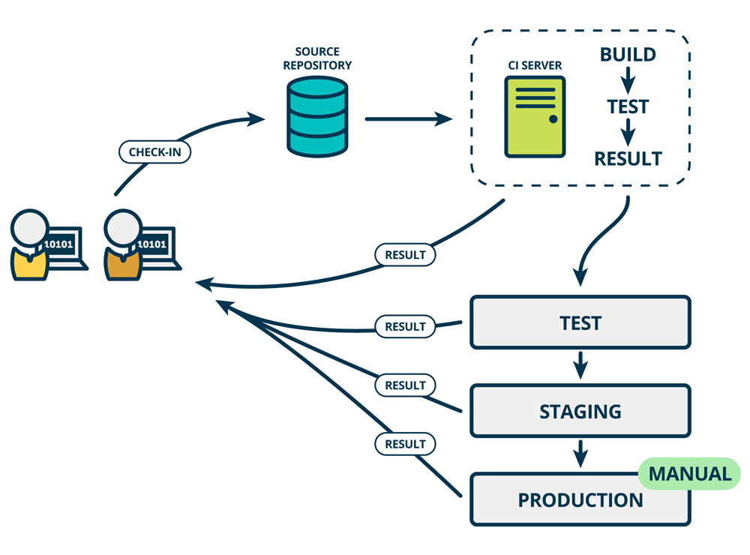
CI/ CD process flow diagram

Slide 7

Branching
Branch
GIT Flow
Environment
Devpro
Hotfix
US of Sprint
TQM
Release
Commit
Commit
Merge
Hot Fix
UAT
Commit
J E N K I N S
Merge
Master
Deploy
PROD
* Deployment to Production using Jenkins becomes infeasible if there are No-Go US in the deployment, as Jenkins deploys the complete package. In such cases, a manual package is prepared to deploy only Go US and puts manual effort and time.

Slide 8



Branching
Branch
GIT Flow
Environment
Request Review
DevPro
Receive Approval
Developer
Reviewer
Deployment POC
`
1
2
3
4
Dev (Daily Check-Ins)
Commit
Empty Branch
Sprint (All US)
Empty Branch
`
Commit
Pick Go US (manual)
Commit
Release (Go US)
Empty Branch
`
J E N K I N S
TQM
Commit
M
Merge
Hotfix
`
Empty Branch
5
Merge
UAT
Master
`
M
Full Codebase
PROD

Slide 9








Tools Used

